Slide 1


Fundamentals of RM
RM System and Process
Leadership in RM
Incident Investigation
RM Tools & Challenges
RM in Industry
People & Org.
Application and Perspectives
On Becoming a
Leader in Risk Management
ENGG404 - Lecture
Chapter 4.2: Cause and Effect Model for Incident Analysis
Chapter 4.3: Root Cause Analysis of an Incident
- Fundamentals -

Slide 2
Learning Outcomes:
Analyze an incident sequentially and explain the nature of the different types of causes, and their sub-categories.
Logically link the causal factors in incident investigations.
Interpret and apply a Cause and Effect Model for analyzing incidents.
Interpret, apply, and construct a Root Cause Analysis of a loss incident.
Differentiate between immediate, intermediate, basic, and latent causes.
Apply the Discovery Model to start the RCA Chart.
This topic explains the purpose and application of the Cause & Effect Model, and the fundamental constructs of a Root Cause Analysis.
Chapter 4.2: C&E Model & Chapter 4.3: RCA of an Incident
2
Notes:
2

Slide 3
Introduction:
Chapters 4.2 and 4.3 teach you how to analyse a loss incident!
Two complementary tools for Incident Investigation:
Cause and Effect Model
Root Cause Analysis Work Process
These will allow you to:
Find all potential cause-effect relationships in a logical manner.
Classify causes by their type such that they can be better understood and recommendations are optimized.
Link incident causes with failures in the RMS.
The RCA WP is applied to analyse a loss incident and create an RCA Chart.
C&E Model is used to check the thoroughness of the RCA Chart.
Chapter 4.2: C&E Model & Chapter 4.3: RCA of an Incident
3
Notes:
3

Slide 4
Important To Keep In Mind:
Learning how to do an RCA is easy!
Learning how to do an RCA well is a struggle!
  Easy to confuse causes, effects, and consequences.
  Easy to jump to conclusions ...
The approach taken here is to build your competency in layers.
First, the facts and sequence of events [timeline] are needed!
(incident investigation work process)
Second, apply the RCA work process to create the RCA Chart.
Third, apply the Cause and Effect Model to check the RCA Chart.
Chapter 4.2: C&E Model & Chapter 4.3: RCA of an Incident
4
Notes:
4

Slide 5
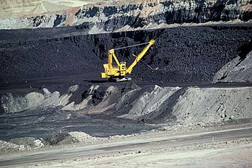
ALE Lead-in: Losses and Causes
This actual “Mine Loss LI” is used in this topic to develop your skills in the
RCA work process. So, put yourself into the role of the supervisor:
You are called to a scene where a mining haul truck and a shovel have been crushed with debris from an adjacent slope. You find one individual with a severe injury. You know the slopes are being monitored, you know there are procedures for safe work near the slopes, and you know it has been raining for the last week.
The losses:
People injured
Equipment value
Operation time loss
Public image
Ore loss
Environmental impact
Chapter 4.2: C&E Model & Chapter 4.3: RCA of an Incident
5
Notes:
5
The aim of this exercise is to pick on their answers in Mentimeter and discuss some of them in terms of “jumping to conclusions”, “facts”, “logic leaps”, etc.
Another aim is to demonstrate that the causation of a loss incident can be explained in rational, sequentially logical terms.

Slide 6
ALE #1: What are the Causes?
Please confer on this question (Open Discussion):
What are some causes of this incident?
Chapter 4.2: C&E Model & Chapter 4.3: RCA of an Incident
6
Notes:
6
The aim of this exercise is to pick on their answers in Mentimeter and discuss some of them in terms of “jumping to conclusions”, “facts”, “logic leaps”, etc.
Another aim is to demonstrate that the causation of a loss incident can be explained in rational, sequentially logical terms.

Slide 7
The Cause and Effect Model:
Unstructured exercise:
The previous exercise was meant to be “unstructured”.
There were many causes, so which one is the correct response?
How can all these causes be logically organized?
In order to logically analyse an incident, one needs to apply the different categories of causes.
The Cause and Effect Model can be used to:
Categorize and summarize the facts of a loss incident.
Communicate the nature of an incident and its causes.
Helps you discern the various different categories of causes, and thus aid in the development of the root cause analysis of a loss incident.
Check the thoroughness of the incident investigation and the root cause analysis.
Note: There are many different C&E Models practiced in industry. This is one of many.
Chapter 4.2: C&E Model & Chapter 4.3: RCA of an Incident
7
Notes:
7

Slide 8
The Cause and Effect Model:
The Five Components of The Cause and Effect Model:
Losses (PEAP)
Incident Description
Immediate Causes in two sub-categories:
  Substandard practices
  Substandard conditions
Basic Causes in three sub-categories:
  Engineering & Design Factors
  Job Factors and sub-groups
  Personal Factors and sub-groups
Latent Causes
Chapter 4.2: C&E Model & Chapter 4.3: RCA of an Incident
8
Notes:
8

Slide 9
The Cause and Effect Model:
Left side:
Two sub-categories of Immediate Causes:
Chapter 4.2: C&E Model & Chapter 4.3: RCA of an Incident
9
Notes:
9
C&E helps you be more specific in terms of losses and causes

Slide 10
The Cause and Effect Model:
Middle:
Three sub-categories of Basic Causes:
This list is not all-inclusive. Sub-sub-categories of causes along similar lines can be added! For example:
E&DF: Inadequate assessment of hazards/risk
E&DF: inadequate monitoring during initial construction/assembly/fabrication
E&DF: inadequate management of change
JF: incompatible goals within the organization
If you cannot find a sub-category that is a direct match, it is acceptable to create another unique sub-sub-category.
Chapter 4.2: C&E Model & Chapter 4.3: RCA of an Incident
10
Notes:
10
C&E helps you be more specific in terms of losses and causes

Slide 11
The Cause and Effect Model:
Right side:
A Risk Management System Element is NOT a latent cause.
A weakness in a RME IS a latent cause.
Chapter 4.2: C&E Model & Chapter 4.3: RCA of an Incident
11
Notes:
11
C&E helps you be more specific in terms of losses and causes

Slide 12
Categories of Causes:
Nature of the different categories of causes:
Immediate Causes – two sub-categories:
Sub-standard Conditions (SCs)
Sub-standard Practices (SPs)
Other terms used: Technical Factors or Actions
Sub-standard = unacceptable, incorrect, improper, inadequate, at-risk
Basic Causes – three sub-categories:
Engineering & Design Factors
Job Factors
Personal Factors
Latent Causes:
Directly associated to failures or weaknesses in the Risk Management System and its elements.
Important! Latent Causes ARE NOT the elements of the Risk Management System
Chapter 4.2: C&E Model & Chapter 4.3: RCA of an Incident
12
Notes:
12

Slide 13
ALE #2: Logical Progression of Causes of an Incident
With this fundamental knowledge, and for our
example of the mining truck loss incident:
“You are called to a scene where a mining haul
truck and a shovel have been crushed with debris
from an adjacent slope. You find one individual with
a severe injury. You know the slopes are being
monitored, you know there are procedures for
safe work near the slopes, and you know it has
been raining for the last week.”
Incident Description: “The slope of an open quarry slid down, debris fell on equipment adjacent to slope causing injury, equipment loss, and production loss”.
Now consider these two questions:
Is it possible to determine which of the following are immediate causes or basic causes, and their relative logical order (on “what caused what)?
What are the immediate causes and the basic causes?
(next pages)
Chapter 4.2: C&E Model & Chapter 4.3: RCA of an Incident
13
Notes:
13

Slide 14
ALE #2: Logical Progression of Causes of an Incident
Incident Description: “The slope of an open
quarry slid down, debris fell on equipment
adjacent to slope causing injury, equipment
loss, and production loss.”
Please confer (pen-to-paper, MM-Poll):
Which are the immediate causes and
which are the basic causes?
Debris fell
Slope was unstable
Truck and shovel were inside the exclusion zone
Supervisor told Operator to work in the exclusion zone
Operator was not trained on exclusion zone procedures
Monitoring data was not evaluated
Chapter 4.2: C&E Model & Chapter 4.3: RCA of an Incident
14
Notes:
14

Slide 15
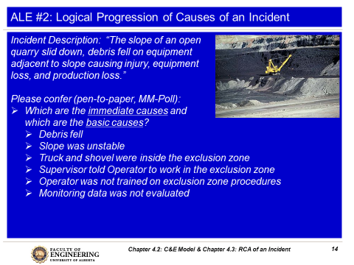
The Intent of the Active Learning Exercise:
The intent of this exercise is
NOT to inform you or test you
on the causes of this LI nor the
category of causes!
The intent of this exercise is to:
Discuss some of the responses in Mentimeter in terms of “jumping to conclusions”, “facts”, “logic leaps”, “combination of causes”, etc.
Demonstrate that the causation of a loss incident must be explained in rational and sequentially logical terms in order to make sense and be of value in determining the latent causes of a loss incident.
Chapter 4.2: C&E Model & Chapter 4.3: RCA of an Incident
15
Notes:
15

Slide 16
Logical Progression of Causes of an Incident:
Incident Description: “The slope of an open quarry
slid down, debris fell on equipment adjacent to slope
causing injury, equipment loss, and production loss.”
Causes:
  Debris fell from the side
  Slope was unstable
  Truck and shovel were inside the exclusion zone
  Supervisor told Operator to work in the exclusion zone
  Operator was not trained on exclusion zone procedures
  Monitoring data was not evaluated
Some points:
  Difficult to decide – immediate or basic!
  Not quite logical … something is missing!
  “AND” and “OR” gates will help structure the logic.
To make sense, the loss incident and its sequence of events are best analysed using the Root Cause Analysis work process and C&E Model!
Chapter 4.2: C&E Model & Chapter 4.3: RCA of an Incident
16
Notes:
16

Slide 17
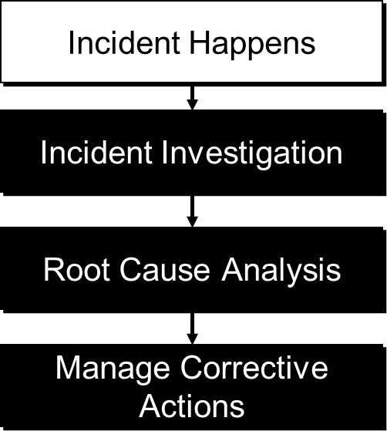
Root Cause Analysis Work Process:
Collect the facts … complete as much of the Incident
Investigation WP before moving on to the RCA WP!
Absolutely necessary that facts of the incident are known
especially the sequence of events leading up to the incident.
Time and effort can be saved by avoiding debate driven by
lack of information, or lack of consensus on plausible events.
Apply the RCA WP to logically breakdown the loss
incident to identify the causes of an incident, including
immediate causes, and
basic causes, and
latent causes;
In other words, to construct the Root Cause Analysis Chart!
The RCA Team identifies actual causes as well as possible, probable, plausible, or conceivable causes.
Chapter 4.2: C&E Model & Chapter 4.3: RCA of an Incident
17
Notes:
17

Slide 18
Root Cause Analysis Work Process:
Purpose, Starting Point, and Outcome:
The RCA WP is intended to drill down to the latent causes.
  Once latent causes (RMS element weaknesses) are identified, needed improvements & recommendations become evident.
The starting point is the Incident Description.
  The RCA reliably describes the sequence of events leading up to the incident – in detail.
The product or outcome of the RCA Work Process is an RCA Chart.
Some benefits:
Focuses on one specific cause at a time.
Identifies all causes through brainstorm thinking, supported by evidence in actual loss incidents under investigation
Provides a visual representation of the incident in a clear and logical manner.
Chapter 4.2: C&E Model & Chapter 4.3: RCA of an Incident
18
Notes:
18

Slide 19
Root Cause Analysis Work Process:
How to Construct a Root Cause Analysis – the Steps:
Define and state the Incident Description.
Ask “what caused this?” i.e. “Ask why?”
For each subsequent cause, ask the same question, “why?”
Immediate causes at the initial levels, followed by basic causes.
Use “AND” and “OR” gates to logically connect causes.
Continue to drill down to ultimately discover the latent causes.
Build sound logic in your RCA Chart - avoid “logic leaps”.
Use the narrative technique: “This … was caused by this … . This … was caused by this … .”
Chapter 4.2: C&E Model & Chapter 4.3: RCA of an Incident
19
Notes:
19

Slide 20
Nomenclature and Symbols for Root Cause Analysis:
How practices (activities, actions, behaviours) and conditions (hazards) are viewed in order to cause an event:
“AND” Gate:
One possibility is a combination of practices must happen
i.e. Practice A AND Practice B
Another possibility is a combination of conditions must be present
i.e. Condition A AND Condition B
And another possibility is a combination of practices must happen and conditions must be present i.e. Practice A AND Condition B.
“OR” Gate:
One of several practice must happen
i.e. Practice A OR Practice B
One of several conditions must be present
i.e. Condition A OR Condition B
One of several practices must happen or conditions must be present i.e. Practice A OR Condition B.
Event
AND
A
B
Event
OR
A
B
Chapter 4.2: C&E Model & Chapter 4.3: RCA of an Incident
20
Notes:
20

Slide 21
Example: “AND” and “OR” Gates
With this knowledge, and for our example of the mining incident:
“You are called to a scene where a mining haul truck and a shovel have been crushed with debris from an adjacent slope. You find one individual with a serious injury. You know the slopes are being monitored, you know there are procedures for safe work near the slopes, you know it had been raining for the last week.”
Think about where the ‘and’ and ‘or’ gates would apply in this case.
Let’s begin with an RCA Chart of this loss incident:
Chapter 4.2: C&E Model & Chapter 4.3: RCA of an Incident
21
Notes:
21

Slide 22
Incident & Losses
Debris fell on equipment, injuring one worker & damaging equipment
Debris Fell
Equipment & Operator Were In Exclusion Zone
  We begin to construct our RCA Chart by starting with an INCIDENT DESCRIPTION AND asking
  “what caused debris to fall on equipment, etc.?”
  Note the use of the AND gate here.
Chapter 4.2: C&E Model & Chapter 4.3: RCA of an Incident
22

Slide 23
Incident & Losses
Debris fell on equipment, injuring one worker & damaging equipment
Debris Fell
Equipment & Operator Were In Exclusion Zone
Unstable slope
Rain
Didn’t follow exclusion zone procedures
No effective warning
Poor slope construction
Poor slope design
Monitoring data not evaluated
No effective communication
Operator not trained on exclusion zone procedures
Supervisor told Op to be inside the exclusion zone
  We continue to construct our RCA Chart by asking “why?” or “what caused…?” Note the use of AND and OR gates to make the logical connections.
Chapter 4.2: C&E Model & Chapter 4.3: RCA of an Incident
23

Slide 24
Use the C&E Model to Find and Categorize the Causes:
The C&E Model is used to categorize all the causes in your RCA Chart.
Recall your Cause and Effect Model … a detailed look:
Immediate Causes in two categories:
Substandard practices and sub-groups
Substandard conditions and sub-groups
Basic Causes in three categories:
Engineering & Design Factors
Job Factors and sub-groups
Personal Factors and sub-groups
Intermediate cause – a cause statement that cannot be readily categorized as any one of IC, BC, or LC.
Latent Causes – will be discussed in much more depth in the next topic.
Chapter 4.2: C&E Model & Chapter 4.3: RCA of an Incident
24
Notes:
24

Slide 25
Immediate Cause Categories and Sub-categories:
Substandard Practices (examples) | Substandard Conditions (examples)
Operating equipment without authority Failure to follow established procedures Making safety devices inoperable Failing to use personal protective equipment Servicing equipment in operation Horseplay Under influence of alcohol, drugs | Inadequate or improper protective equipment Defective tools, equipment or materials Inadequate warning systems Fire and explosion hazards (hidden) Poor housekeeping; disorderly workplace Hazardous environmental conditions Noise exposures Inadequate ventilation
Chapter 4.2: C&E Model & Chapter 4.3: RCA of an Incident
25
Notes:
25

Slide 26
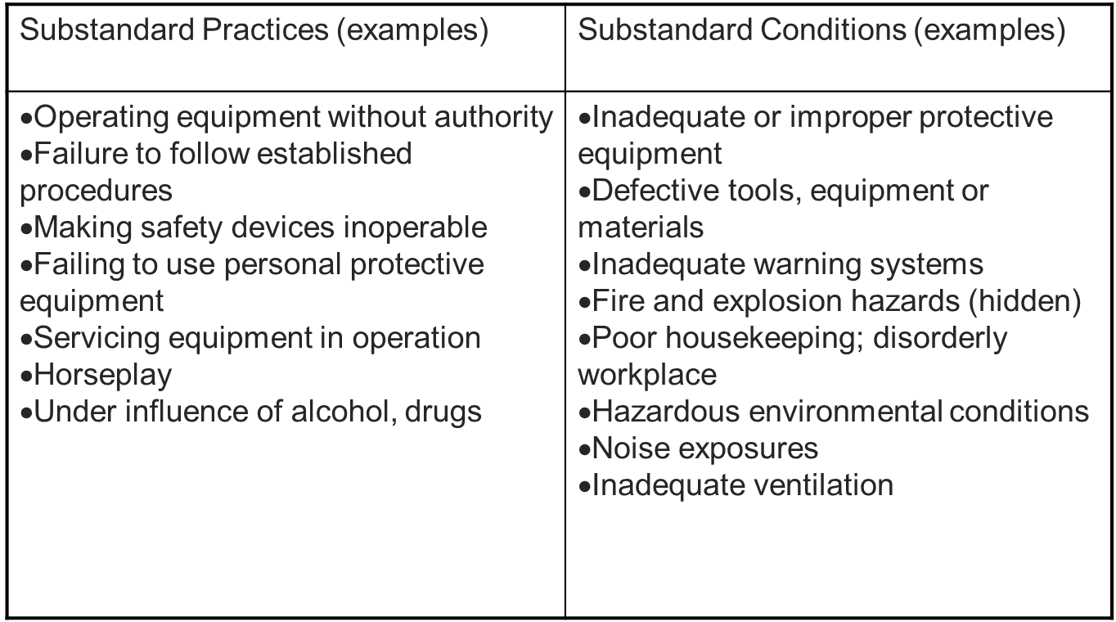
Immediate Cause Categories & Sub-categories Detailed Lists:
Chapter 4.2: C&E Model & Chapter 4.3: RCA of an Incident
26
Notes:
26

Slide 27
Incident Description
Debris fell on equipment, injuring one worker & damaging equipment
Debris Fell
Equipment & Operator Were In Exclusion Zone
Unstable slope
Rain
Didn’t follow exclusion zone procedures
No effective warning
Poor slope construction
Poor slope design
Monitoring data not evaluated
No effective communication
Operator not trained on exclusion zone procedures
Supervisor told Op to be inside the exclusion zone
Can you identify three immediate causes?
Chapter 4.2: C&E Model & Chapter 4.3: RCA of an Incident
27

Slide 28
Incident Description
Debris fell on equipment, injuring one worker & damaging equipment
Immediate Causes
Debris Fell
Equipment & Operator Were In Exclusion Zone
Unstable slope
Rain
Didn’t follow exclusion zone procedures
No effective warning
Poor slope construction
Poor slope design
Monitoring data not evaluated
No effective communication
Operator not trained on exclusion zone procedures
Supervisor told Op to be inside the exclusion zone
How could these three immediate causes be categorized?
Sub-standard condition?
Sub-standard work practice?
Chapter 4.2: C&E Model & Chapter 4.3: RCA of an Incident
28

Slide 29
Incident Description
Debris fell on equipment, injuring one worker & damaging equipment
Immediate Causes
Debris Fell
Equipment & Operator Were In Exclusion Zone
Unstable slope
Rain
Didn’t follow exclusion zone procedures
No effective warning
Poor slope construction
Poor slope design
Monitoring data not evaluated
No effective communication
Operator not trained on exclusion zone procedures
Supervisor told Op to be inside the exclusion zone
Sub-standard condition
Sub-standard work practice
Sub-standard work practice
Chapter 4.2: C&E Model & Chapter 4.3: RCA of an Incident
29

Slide 30
Incident Description
Debris fell on equipment, injuring one worker & damaging equipment
This is an “event” in the incident.
Immediate Causes
Debris Fell
Equipment & Operator Were In Exclusion Zone
Intermediate Causes
Unstable slope
Rain
Didn’t follow exclusion zone procedures
No effective warning
Basic Causes
Poor slope construction
Poor slope design
Monitoring data not evaluated
No effective communication
Operator not trained on exclusion zone procedures
Supervisor told Op to be inside the exclusion zone
“1st immediate cause” in the root pathway
“2nd immediate cause” in the root pathway
“1st immediate cause” in the root pathway
Sub-standard condition
Sub-standard work practice
Sub-standard work practice
Chapter 4.2: C&E Model & Chapter 4.3: RCA of an Incident
30

Slide 31
ALE #3: Immediate Causes - Categories and Sub-categories
Please confer (pen-to-paper, response on MM not intended):
From our Mining LI, identify the category and sub-category for each of these three Immediate Causes:
Unstable slope
Equipment & operator in exclusion zone
Operator didn’t follow exclusion zone procedures
Substandard Practices (examples) | Substandard Conditions (examples)
Operating equipment without authority Failure to follow established procedures Making safety devices inoperable Failing to use personal protective equipment Servicing equipment in operation Horseplay Under influence of alcohol, drugs | Inadequate or improper protective equipment Defective tools, equipment or materials Inadequate warning systems Fire and explosion hazards (hidden) Poor housekeeping; disorderly workplace Hazardous environmental conditions Noise exposures Inadequate ventilation
Chapter 4.2: C&E Model & Chapter 4.3: RCA of an Incident
31
Notes:
31

Slide 32
Example: Immediate Causes - Categories and Sub-categories
The category and sub-category for each of these three Immediate Causes:
Unstable slope
Equipment & operator in exclusion zone
Operator didn’t follow exclusion zone procedures
(See NOTES below.)
Substandard Practices (examples) | Substandard Conditions (examples)
Operating equipment without authority Failure to follow established procedures Making safety devices inoperable Failing to use personal protective equipment Servicing equipment in operation Horseplay Under influence of alcohol, drugs | Inadequate or improper protective equipment Defective tools, equipment or materials Inadequate warning systems Fire and explosion hazards (hidden) Poor housekeeping; disorderly workplace Hazardous environmental conditions Noise exposures Inadequate ventilation
b) c) Failure to follow established procedures (Admin. Controls: safety rules, policies, etc.)
a) Hazardous environmental conditions
Chapter 4.2: C&E Model & Chapter 4.3: RCA of an Incident
32
Notes:
32
You may have noticed on the RCA Chart that some of these were aligned with “Immediate Cause” and some with “Intermediate Cause”. An intermediate cause can link an immediate cause to a basic cause but if it can clearly be categorized and sub-categorized as an “Immediate Cause”, then that is quite acceptable; and it is quite acceptable to have an immediate cause caused by another immediate cause.

Slide 33
Basic Causes and Categories:
Engineering & Design Factors: (can apply to structures, equipment, tools, products, raw materials, i.e. any engineered system) | Job Factors: | Personal Factors:
inadequate technical design inadequate ergonomic design inadequate assessment of loss exposures inadequate standards, specifications and/or design criteria inadequate monitoring of construction inadequate assessment of operational readiness inadequate monitoring of initial operation inadequate evaluation and/or documentation of change inadequate inherently safe design | Inadequate maintenance Inadequate job procedures Error-inducing conditions Organizational factors Incompatible goals Inadequate training Inadequate communication | Inadequate physical / physiological state / capability to do the work. Perceived inadequate mental / psychological state / capability to do the work. Physical or physiological stress. Perceived mental or psychological stress. Improper risk taking / improper motivation Lack of knowledge / lack of skill.
Chapter 4.2: C&E Model & Chapter 4.3: RCA of an Incident
33
Notes:
33

Slide 34
Basic Causes (Engineering / Job / Personal Factors):
How do you identify basic causes?
Difficult to identify; often not evident until after an incident has been investigated and analyzed.
Two Questions to ask to get the Basic Causes:
Why did that substandard condition exist?
Why did that substandard practice occur?
Note: There may be “intermediate causes” or more immediate causes between the “first immediate cause” and the “first basic cause” in a root.
Chapter 4.2: C&E Model & Chapter 4.3: RCA of an Incident
34
Notes:
34

Slide 35
Incident Description
Debris fell on equipment, injuring one worker & damaging equipment
Immediate Causes
Debris Fell
Equipment & Operator Were In Exclusion Zone
Intermediate Causes
Unstable slope
Rain
Didn’t follow exclusion zone procedures
No effective warning
Basic Causes
Poor slope construction
Poor slope design
Monitoring data not evaluated
No effective communication
Operator not trained on exclusion zone procedures
Supervisor told Op to be inside the exclusion zone
How could our basic causes be categorized?
Job factors, Personal Factors, Engineering & Design Factors?
Chapter 4.2: C&E Model & Chapter 4.3: RCA of an Incident
35

Slide 36
ALE #4: Basic Causes and Categories
Please confer (pen-to-paper, response on MM not intended):
What are the basic cause categories for the following?
Poor slope design
Operator not trained on exclusion zone procedures
Supervisor told Operator to be in exclusion zone
Engineering & Design Factors: (can apply to structures, equipment, tools, i.e. any engineered system) | Job Factors: | Personal Factors:
inadequate technical design inadequate ergonomic design inadequate assessment of loss exposures inadequate standards, specifications and/or design criteria inadequate monitoring of construction inadequate assessment of operational readiness inadequate monitoring of initial operation inadequate evaluation and/or documentation of change inadequate inherently safe design | Inadequate maintenance Inadequate job procedures Error-inducing conditions Organizational factors Incompatible goals Inadequate training Inadequate communication | Inadequate physical / physiological state / capability to do the work. Perceived inadequate mental / psychological state / capability to do the work. Physical or physiological stress. Perceived mental or psychological stress. Improper risk taking / improper motivation Lack of knowledge / lack of skill.
Chapter 4.2: C&E Model & Chapter 4.3: RCA of an Incident
36
Notes:
36

Slide 37
Example: Basic Causes and Categories
The basic cause categories for the following:
Poor slope design
Operator not trained on exclusion zone procedures
Supervisor told Operator to be in exclusion zone
Engineering & Design Factors: (can apply to structures, equipment, tools, i.e. any engineered system) | Job Factors: | Personal Factors:
inadequate technical design inadequate ergonomic design inadequate assessment of loss exposures inadequate standards, specifications and/or design criteria inadequate monitoring of construction inadequate assessment of operational readiness inadequate monitoring of initial operation inadequate evaluation and/or documentation of change inadequate inherently safe design | Inadequate maintenance Inadequate job procedures Error-inducing conditions Organizational factors Incompatible goals Inadequate training Inadequate communication | Inadequate physical / physiological state / capability to do the work. Perceived inadequate mental / psychological state / capability to do the work. Physical or physiological stress. Perceived mental or psychological stress. Improper risk taking / improper motivation Lack of knowledge / lack of skill.
a) Inadequate technical design
b) Inadequate training
c) Improper motivation / improper risk taking
Chapter 4.2: C&E Model & Chapter 4.3: RCA of an Incident
37
Notes:
37

Slide 38
Key Points:
The Intent of The Tables of Detailed Lists:
Tables help guide the user in categorizing the incident details including the immediate and basic causes.
FYI: These tables are not exhaustive and all-inclusive; there may be other sub-sub-categories that can be created.
Categorization of Causes:
When reporting the categories of a cause, it is important to recognize the major category, the sub-category, and the sub-sub-category
e.g. basic cause, job factor, inadequate training.
Latent causes will be discussed in detail in the next topic.
Chapter 4.2: C&E Model & Chapter 4.3: RCA of an Incident
38
Notes:
38

Slide 39
Example: Tools to Start the RCA:
Incident Description: “The slope of an open quarry slid down, debris fell on equipment adjacent to slope causing injury, equipment loss, and production loss.”
Sometimes, it is difficult to get started on an RCA.
What tools can you use to start your RCA after you have learned about the incident and summarized your incident description?
a) Simply ask “why?” b) RM Program? c) The Discovery Approach?
d) RM Work Process? e) Semi-Quantitative Risk Assessment?
The slope slid, debris fell on equipment, injuring one worker & damaging equipment
?
?
?
Chapter 4.2: C&E Model & Chapter 4.3: RCA of an Incident
39
Notes:
39

Slide 40
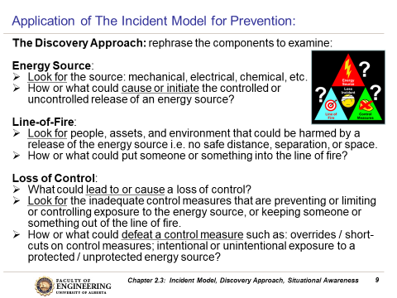
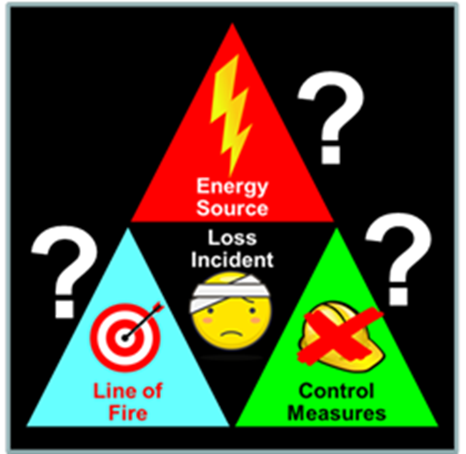
“Ask Why?” and The Discovery Approach
After a detailed incident description is written, summarise it, then:
“Ask Why?”, as demonstrated in the previous slides, and the
Discovery Approach are suitable.
See topic #11 Chapter 2.3: Hazards and Hazard Identification to review The Discovery Approach
The Discovery Approach is much more methodical:
Chapter 4.2: C&E Model & Chapter 4.3: RCA of an Incident
40
Notes:
40

Slide 41
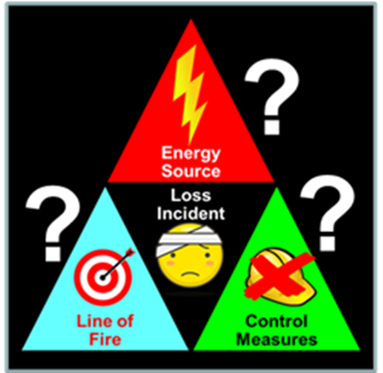
ALE #5: Apply the Discovery Approach in an RCA:
Please confer and respond (Open discussion):
What are the responses to the questions when applying
“The Discovery Approach”?
Discovery Approach:
  Energy Source?
  Line-of-Fire?
  Lack of or No Safeguard?
The slope slid, debris fell on equipment, injuring one worker & damaging equipment
?
?
?
Energy Source:
?
Line-of-Fire:
?
Loss of Control:
?
Chapter 4.2: C&E Model & Chapter 4.3: RCA of an Incident
41
Notes:
41

Slide 42
Example: Apply the Discovery Approach in an RCA:
The example shown here is but one of many ways to start constructing the RCA chart based on the summarized incident description. As you progress through the RCA chart by “asking why”, the logical order of these causes may be changed in order to make each of the developing roots in the chart flow logically and smoothly.
The slope slid, debris fell on equipment, injuring one worker & damaging equipment
Debris fell
Slope was unstable
Equipment and People in the area
Exclusion zone not marked
Energy Source:
gravity
Energy Source:
instability
Line-of-Fire:
people & equipment
Loss of Control:
No physical barrier
Chapter 4.2: C&E Model & Chapter 4.3: RCA of an Incident
42
Notes:
42

Slide 43
Summary and Key Lessons:
Summary:
This topic explains the purpose and application of the Cause & Effect Model, and the fundamental constructs of a Root Cause Analysis.
The Detailed Cause & Effect Model is introduced as a means to understand and explain the various different categories of causes.
The RCA Work Process is introduced as a means to logically discover and arrange all of the causes leading to an incident.
  The RCA WP starts with the Incident Description, and proceeds through immediate causes, basic causes, and latent causes.
  “Ask why?” can be applied throughout the RCA
Key Lessons:
The RCA work process is used to create an RCA Chart.
The Discovery Approach can be applied to start the RCA.
After the chart has been created, the Cause & Effect Model is used to:
Categorize the causes in an RCA Chart,
Check the thoroughness and quality of an RCA Chart, and
Revise the RCA Chart to make improvements on it.
Chapter 4.2: C&E Model & Chapter 4.3: RCA of an Incident
43
Notes:
43

Slide 44
Any questions?
Notes:
44

